Slide 1

Stage 2 The Polish Do It Like This Course Designer: Marcel Englmaier
The Polish Do It Like This is a 11 round, 55 point Comstock Medium course. There are 4 USPSA targets and 3 steel targets. The best two hits per target will score. Steel must fall to score. The start signal is audible.
The Handgun start position is standing with heels touching marks and wrists below belt. Handgun unloaded and holstered. The PCC start position is standing with heels touching marks. PCC unloaded with stock touching belt and muzzle pointed down range. Both hands holding PCC.
On the audible start signal, engage all targets from within the shooting area. Rhino KD activates Swinger which is visible at rest.

Slide 2
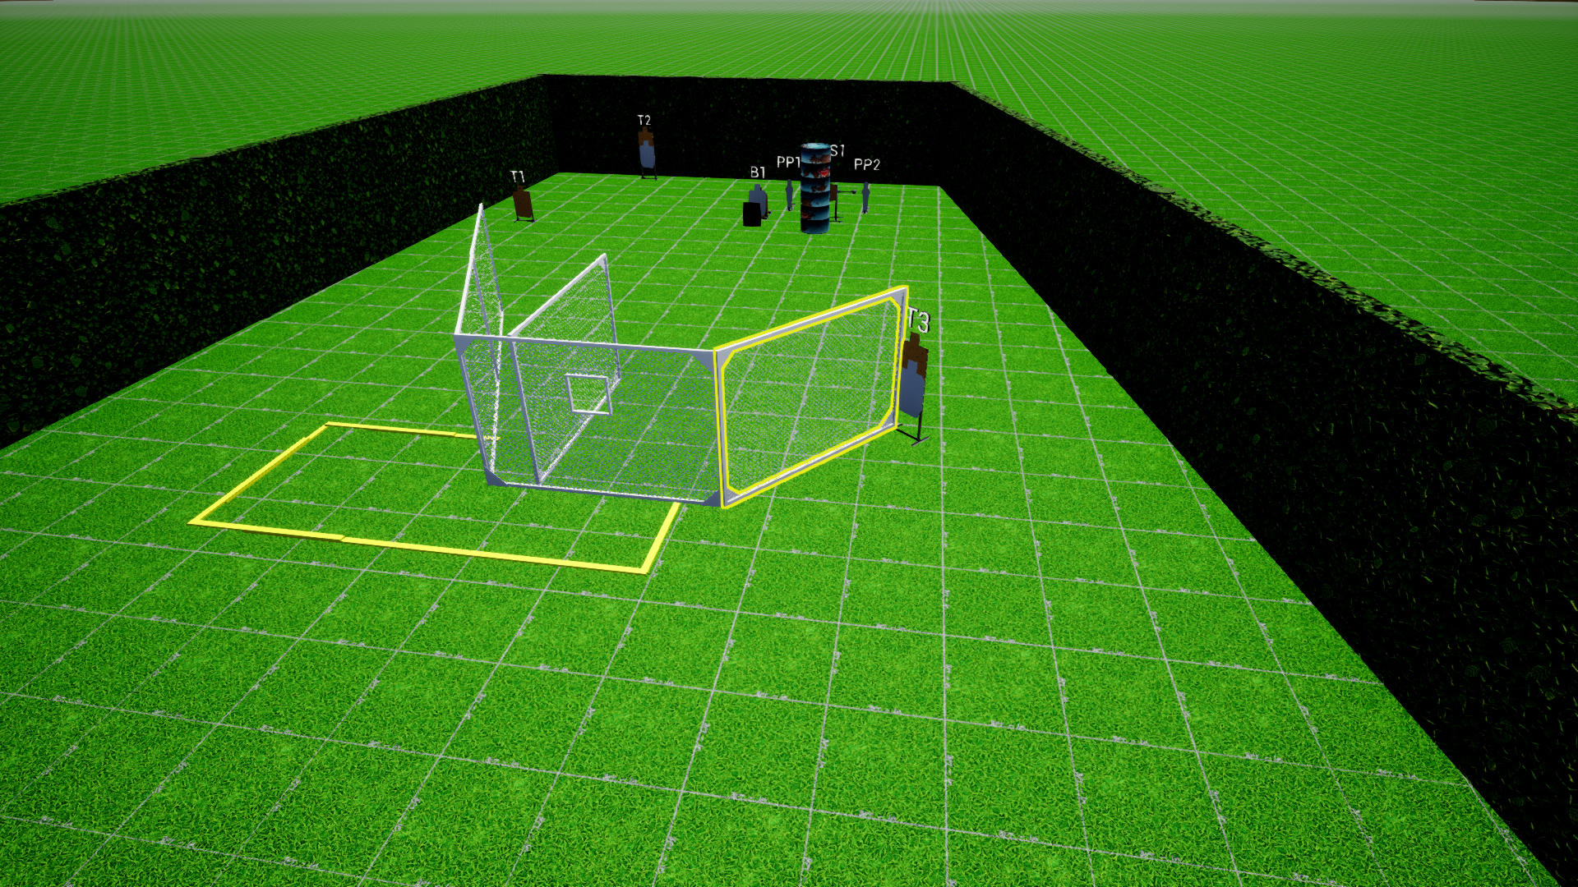
 | Stage 2 The Polish Do It Like This Course Designer: Marcel Englmaier

